Slide 1
Drawing Automation
02 May 2019

Slide 2
Introduction
A Compression matrix of program.
AutoCAD
Solid works
Aoexchange
pydraw

Slide 3
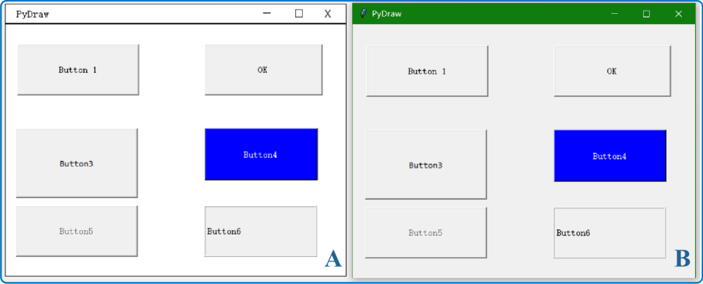
Py-draw
Py draw module to create the schematic charts.

Slide 4
AutoCAD referance
https://buildmedia.readthedocs.org/media/pdf/pyautocad/latest/pyautocad.pdf
http://firsttimeprogrammer.blogspot.com/2017/09/let-python-do-job-for-you-autocad.html
https://pypi.org/project/pyautocad/

Slide 5
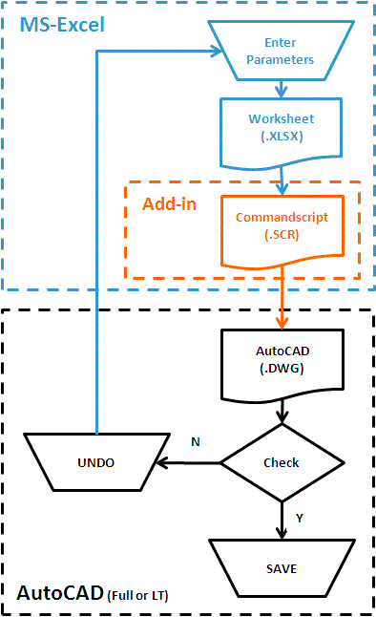
AutoCAD with Excel

Slide 6
aoc-xchange
The aoc-xchange project provides a Python package named aocxchange to read and write from/to IGES, STEP, BREP, and STL files using PythonOCC.
aocxchange can also read 2D foil section definition files (.dat files)
PythonOCC is a set of Python wrappers for the OpenCascade Community Edition (an industrial strength 3D CAD modeling kernel)

Slide 7
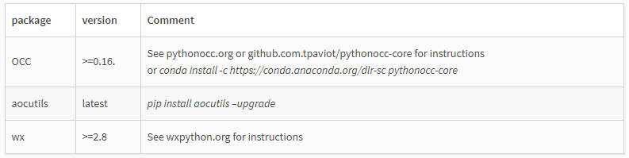
aoc-xchange- Dependencies
aocxchange depends on OCC >=0.16 and aocutils. The examples require wx>=2.8 (or another backend (minor code modifications required)).

Slide 8
Way Forward
Solid works are automating with the api and c++.
I didn’t found any source for solidworks with using python.

Slide 9
Conclusion
We can built the part drawings using co-ordinate system in python and excel scripts in autocad.
https://pypi.org/project/pyacadcom/

Slide 10
THANK YOU
For the opportunity to serve!

Slide 11
Document Revision History
01 | New document | 16 June 2016 |  | VA
Rev | Description | Date |  | Author | Checked | Approved
Document No: |  |  | Client Ref:
0132-PRE-0001-01 |  |  | n/a

